Slide 1
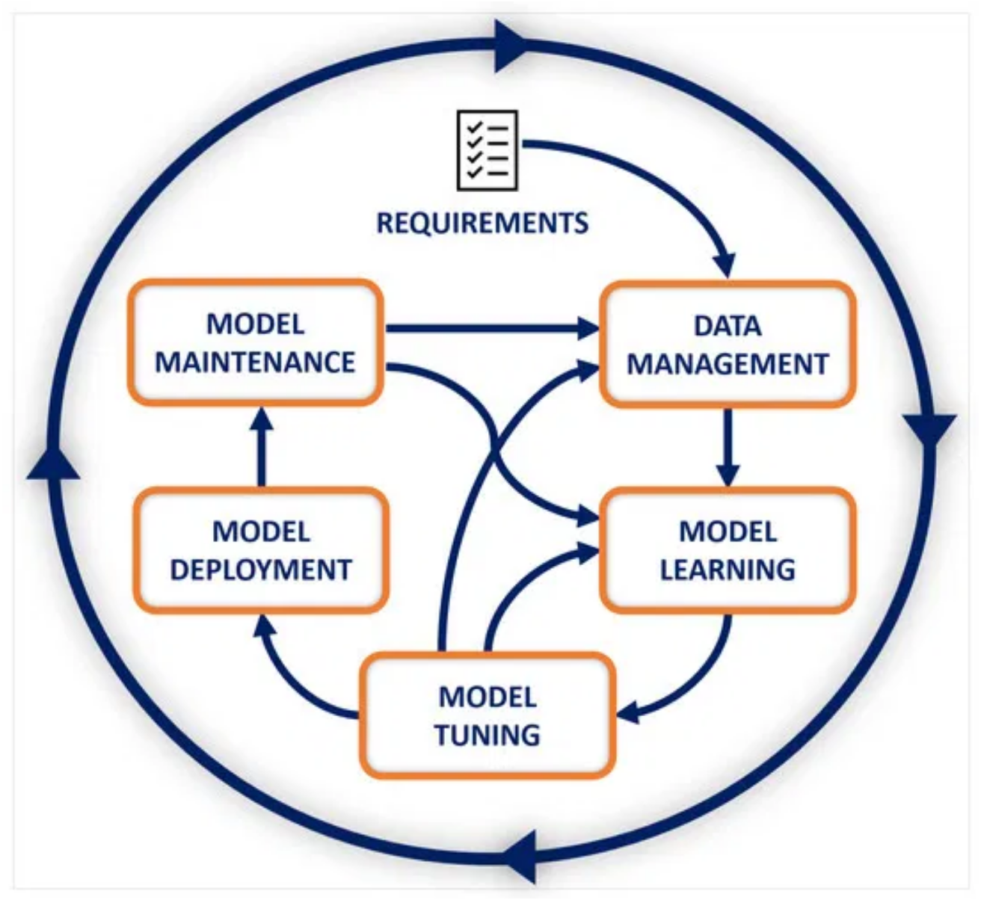
AI Security
Presented by: Reem AL-ZOUHBY
Internship Presentation
18/7/2025

Slide 2
Presentation Plan
Introduction
Why AI needs Security?
Threat modeling for AI
AI Testing
AI Privacy

Slide 3

1.INTRODUCTION

Slide 4
What is AI?
AI refers to systems that simulate human intelligence to perform tasks like:
Learning from data( Machine Learning)
Understanding Language (NLP)
Recognizing images or speech
Making decision
Examples: ChatGPT, Cloud , Manus ….

Slide 5
What is AI Security?
AI Security is the application of cybersecurity principles and practices to Artificial Intelligence systems. It involves protecting AI models, data, and infrastructure from malicious attacks, vulnerabilities, and unintended behaviors.
Key Aspects of AI Security:
Data security : Protecting Training data , input data , output data from unauthorized access, tampering or leakage.
Model security :Safeguarding Ai model from adversarial attacks
IT security :Secure the underlying software, hardware and network infrastructure that support AI system.
Privacy security: Addressing ethical implementations such as bias , fairness, transparency and accountability in Ai system.

Slide 6

2.Why AI need security???

Slide 7
Why AI needs Security?
The increasing adoption of AI across various industries brings significant benefits but also introduces new and complex security challenges.
AI models are vulnerable to various attacks:
Adversarial inputs: Maliciously crafted data can trick AI into making wrong decisions. (e.g. a slightly modified image misclassified by a vision model)
Model poisoning: Attackers can manipulate training data to embed backdoors.
Model extraction: Attackers can steal proprietary models via APIs.
Model inversion: Attackers can recover sensitive training data from the model.
These risk affect the confidentiality , integrity , availability of AI system.

Slide 8
3. Threat modeling for AI

Slide 9
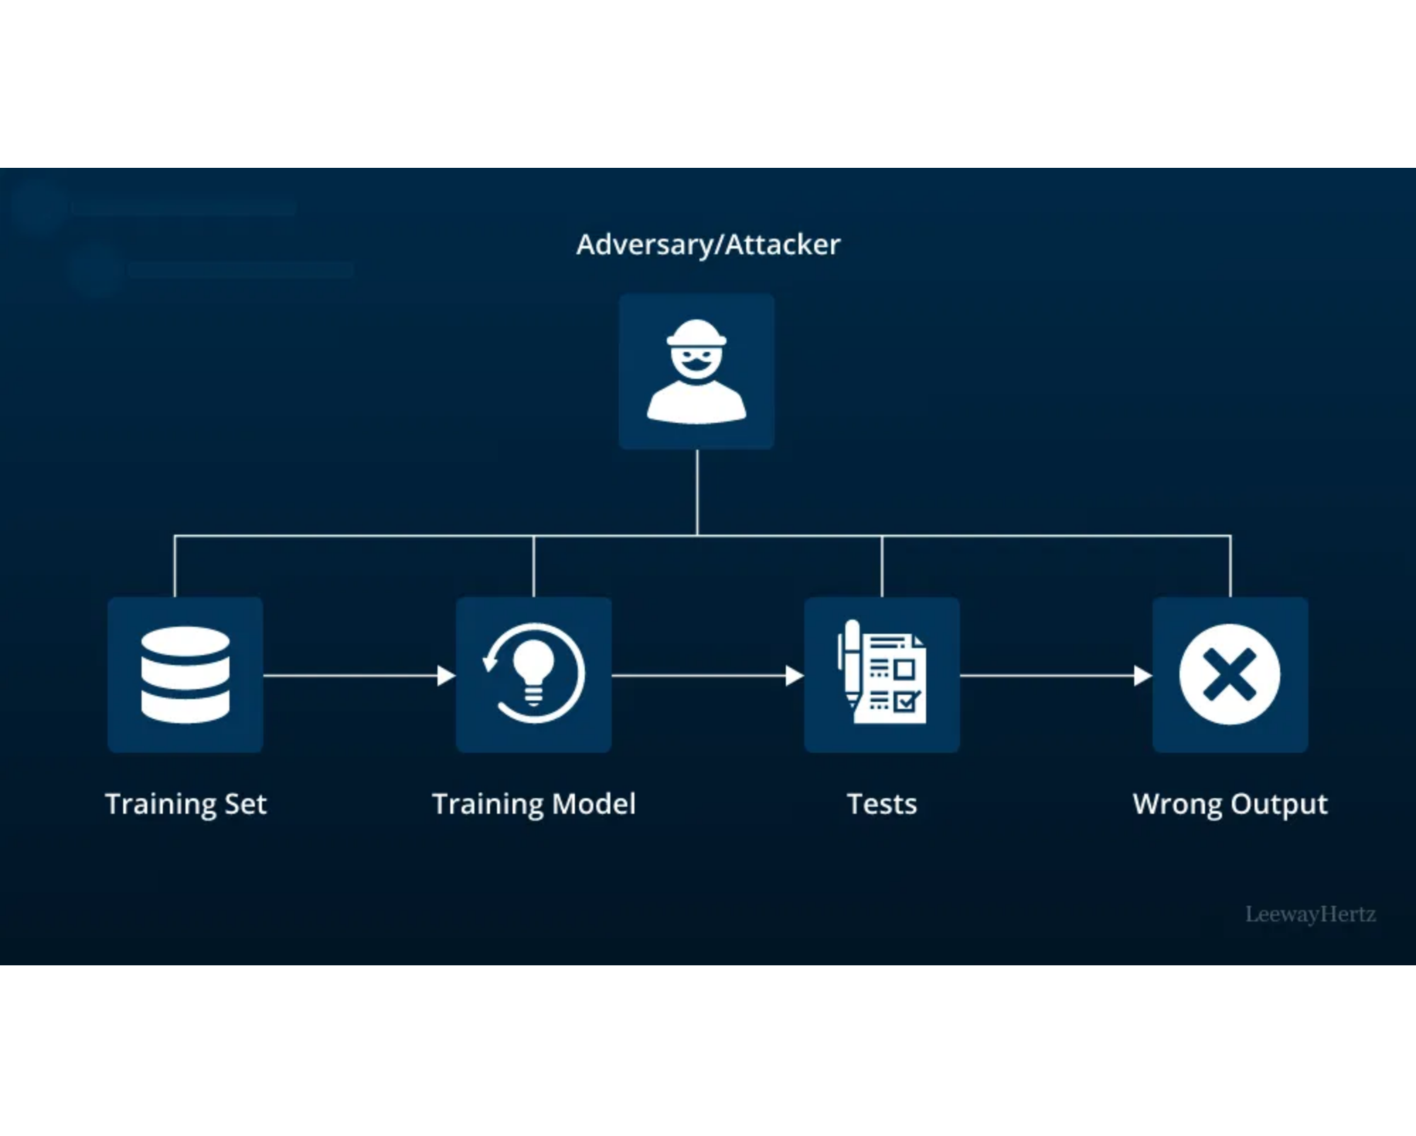





Threat modeling for AI
Threat modeling is a structured approach to identify, quantify, and address potential threats to AI systems. It helps organizations proactively identify vulnerabilities and design appropriate security controls throughout the AI system lifecycle.
Key Steps in AI Threat Modeling:
Identify Assets:
Determine valuable components including data,
models, algorithms, and infrastructure.
Identify Threats:
Enumerate potential attacks and vulnerabilities
that could compromise assets.
Identify Vulnerabilities:
Analyze system design,
implementation, and deployment to pinpoint weaknesses.
Determine Risks:
Assess likelihood and impact of each identified
threat and vulnerability.
Develop Countermeasures:
Design and implement security
controls to mitigate identified risks.

Slide 10
Threat modeling for AI
Benefits of AI Threat Modeling:
Proactive Security: Identifies and addresses security issues early
Comprehensive Coverage:
Ensures both traditional and AI-specific threats are considered.
Risk Prioritization:
Helps focus on critical risks and allocate resources effectively.

Slide 11
3.1. Threat Through use

Slide 12
Threat through use
Threats through use take place through normal interaction between user and AI model
Examples:
Malicious inputs to fool the model
Attempts to steal sensitive data or model logic
Controls to prevent:
#MONITORUSE
#RATELIMIT
#MODELACCESSCONTROL

Slide 13
Threat Type1 : Evasion Attacks
Goal: Fool the AI into making wrong predictions
How?
Modify input slightly (adversarial example)
Human can't notice changes, but AI does
Types:
Digital & Physical
Targeted vs Untargeted

Slide 14
Key Controls:
#DETECTODDINPUT
Detect odd input: significantly different from the training data or even invalid also called input validation
Purpose: odd input can result in unwanted model behaviour because the model not seen this data so the results produce is false , not necessary all input odd is input malicious and also not all input malicious is an odd input.

Slide 15
How detect the odd input???
Types of detection of odd input:
OOD (out of distribution)
Using techniques like similarity measures between training and test data .
Form of OOD ( techniques used)
1-Outlier detection (OD)
Identifying data points that are significantly different from the majority of the data .
Note: not all the outliers is OOD
2-Anomaly Detection (AD)
the key aspect is their significance in terms of indicating a problem or rare event.
3-open set Recognition(OSR)
During operation , systems identifies various known objects ( identify classes)
If see an object unrecognition is called unknown ( not say a false decision)

Slide 16
4-Novelty Detection(ND)
Recognize unfamiliar inputs that are likely relevant even if not a part of the training data
New input but not malicious
Examples : model AI trained only on car until 2020 if see car 2025 it is classified it as cars but new ( not a threat but should be attention that is a new probably a car )
Your AI system for self-driving cars was trained on car models from 2020 and earlier. One day, it sees a brand-new car model from 2025. Even though the system has never seen it, Novelty Detection allows it to recognize: "This is new, but probably a car" — rather than treating it as a threat.

Slide 17
#DETECTADVERSARIALINPUT
Detecting adversarial input involves several techniques to identify inputs designed to deceive the AI model:
Statistical Analysis Techniques:
PCA (Principal Component Analysis): Detects anomalies by reducing dimensionality and spotting deviations from typical data patterns.
SSIM (Structural Similarity Index Measure): Used to compare visual inputs (e.g., images) to detect small adversarial changes.
Detection Networks:
These are specialized models trained to distinguish between benign and adversarial inputs.
They can function as pre-processing layers or in parallel with the main model, analyzing hidden layers for suspicious behavior.
Input Distortion Techniques:
Purposefully modify the input (e.g., add noise, compress using JPEG, or blur) and observe how the model’s output changes.
A significant difference in prediction between the original and distorted input indicates potential adversarial behavior.
Techniques include:
Feature Squeezing: Reduces input precision to minimize adversarial noise.
Randomized Smoothing: Adds noise to the input to improve model robustness.
These methods are essential for enhancing the model’s resilience against evasion attacks and detecting suspicious patterns effectively.

Slide 18
#EVASIONROBUSTMODEL: Build robust architectures
Tools: ART, Foolbox, CleverHans
#TRAINADVERSARIAL: Train with adversarial samples
#ADVERSARIALROBUSTDISTILLATION: First , train the teacher model normally
Then , a student model is trained not on the hard labels but on the soft outputs(probability distributions)
#INPUTDISTORTION: Use randomization/smoothing

Slide 19
Methodes of Evasion Attack
Closed-box vs Open-box Evasion
 | White-box | Black-box
Model Access | Full (architecture + weights) | No internal access
Gradients | Directly computed | Must be estimated
Efficiency | More efficient | More trial-and-error
Techniques | FGSM, PGD, CW, UAPs | Transfer-based, Query-based

Slide 20
Evasion after Poisoning
After training data has been poisoned (see data poisoning section), specific input (called backdoors or triggers) can lead to unwanted model output.
Term | Meaning
Trigger / Backdoor | The special input that causes the poisoned model to behave incorrectly
Poisoned Sample | A training data point crafted to inject the backdoor
Clean Label Attack | A form of poisoning where the poisoned samples are labeled correctly, making detection even harder

Slide 21
Type2: Prompt injection
Trick LLMs via malicious prompt content
Two types:
Direct ("Ignore all instructions and...")
Indirect (malicious content in PDF, website, etc.)
Controls:
#PROMPTINPUTVALIDATION
#INPUTSEGREGATION

Slide 22
Direct prompt injection
What is???
A user sends instructions directly in the prompt to override the model’s safeguards( e.g. ignore earlier instruction….)
The attackers (prompting user) can get offensive or confidential content. Model itself remains intact

Slide 23
Indirect prompt injection
Hidden or malicious instructions are embedded in external data (e.g., websites, documents) that are then included in the prompt context, causing the model to execute unintended actions.
Impact: Can trigger unwanted behavior via trusted external sources—effectively remote code execution for LLMs .
Controls:
#INPUTSEGREGATION
Clearly label or tag untrusted user input (e.g., ChatML tags or prefix/suffix) to distinguish it from system instructions .

Slide 24
Type3 : Sensitive data disclosure through use
Impact: Confidentiality breach of sensitive training data.
Sensitive data output from model
The output of the model may contain a personal data that was part of its training model.
Controls:
#FILTERSENSITIVEMODELOUTPUT
Filter sensitive model output: actively censor sensitive data by detecting it when possible (e.g. phone number).

Slide 25
Type 4 : Model inversion and Membership inference
Model inversion (or data reconstruction) occurs when an attacker reconstructs a part of the training set by intensive experimentation during which the input is optimized to maximize indications of confidence level in the output of the model.
Controls
#OBSCURECONFIDENC
Obscure confidence: exclude indications of confidence in the output, or round confidence so it cannot be used for optimization
#SMALLMODEL
Make the model small ( samples not large not include any personal information ) that prevent the overfitting

Slide 26
Model theft through use
Impact: Confidentiality breach of model parameters, which can result in intellectual model theft and/or allowing to perform model attacks on the stolen model that normally would be mitigated by rate limiting, access control, or detection mechanisms.
It occurs when an attacker collects inputs and outputs of an existing model and uses those combinations to train a new model, in order to replicate the original model.

Slide 27
Type 5: Failure or malfunction of AI-specific elements through use
Impact: AI is unavailable
A sponge attack or energy latency attack provides input that is designed to increase the computation time of the model, potentially causing a denial of service.
Controls:
#DOSINPUTVALIDATION
Input validation before treat it and reject the large input or malicious.
#LIMITRESOURCES
Limit resource usage for a single model input , to prevent resource overuse.

Slide 28
3.2.Development time Threat

Slide 29
Development-time threats
At development time, AI systems face unique threats that differ from traditional software. That’s because we’re not only dealing with code but also highly sensitive data and pre-trained models.

Slide 30
Particularities of AI Development Environments
Real-world data is sensitive and often personal
Code, configs, and parameters are intellectual property
Supply chain includes data & models, not just code
External components (e.g., libraries) may be malicious

Slide 31
Development Security Controls
Integrate AI assets into security management
Apply access control, encryption, and monitoring
Limit privileges to only what’s necessary
Protect: code, data, configs, models #DEVSECURITY | #DEVDATAPROTECT

Slide 32
Protection Strategie
Encryption of the data
Technical access to limit the access following the least privilege principal.
Operational security to protect stored data .

Slide 33
Integrity check
Part of development security is checking integrity of assets. These assets include tarin/test/validation data and model parameters, source code and binaries.
Integrity checks can be performed at various stages including build, deploy, and supply chain management

Slide 34
Integrity checks –build stage
Build stage when writing code , prepare datasets and assembling components before the training model
Code Signing: Use digital signatures
Checksums: Detect file tampering (e.g., SHA256)
Dependency Checks: Avoid vulnerable libraries (e.g., via SCA tools)
CI Testing: Run automated tests for functionality & security

Slide 35
Integrity Checks – Deploy Stage
When u move the trained model and system to production environment.
Secure Config: Use Terraform, Ansible, IaC tools
Controlled Deployment: CI/CD with rollback support
Runtime Monitoring: Use tools like RASP, Falco for alerts
Track deployed versions and access logs

Slide 36
Supply Chain Management
Supply chain threats come from external components (models, datasets, libraries).
Component Authenticity
Making sure the data/models/code you got from third parties are legit.
How to do it:
Require cryptographic signatures.
Ask for security documentation or attestation from vendors.
Example: You use a pre-trained model from Hugging Face. You verify its SHA256 hash matches the official one.

Slide 37
Supply Chain Controls
#SUPPLYCHAINMANAGE: Verify component authenticity
Use SBOM / AIBOM for traceability
Integrity checks: hashes, signatures
Apply regular security patching

Slide 38
Data Segregation for Security
Isolate data across secured zones
External zone → Data engineering zone → Model training zone → App zone → Operations zone
Access controls for each stage #SEGREGATEDATA

Slide 39
Confidential Compute & Federated Learning
Confidential Compute: Protects data during runtime
Federated Learning: Trains models locally, no raw data transfer
Improves privacy, compliance, and bandwidth use #CONFCOMPUTE | #FEDERATEDLEARNING

Slide 40
Federated Learning – Benefits
Benefit | Explanation
Regulatory Compliance | No raw data transfer (e.g., GDPR)
Confidentiality | Only updates shared, not data
Scalability | Less bandwidth, local computation
Data Diversity | Models trained on diverse sources

Slide 41
Type1 :Broad Model Poisoning Threats
Data Poisoning: Inject bad training data
Environment Poisoning: Modify code/configs during training
Supply Chain Poisoning: Use pre-poisoned models
Goal: Change model behavior Impact: Integrity of model output

Slide 42
Data Poisoning – Types & Controls
Type | Description
Backdoor | Attack works on specific input
Sabotage | General decrease in accuracy
Controls:
#MORETRAINDATA
#DATAQUALITYCONTROL
#TRAINDATADISTORTION
#POISONROBUSTMODEL
#MODELENSEMBLE
#TRAINADVERSARIAL

Slide 43
Development Environment Poisoning
Attack targets model code, configs, or parameters
Happens during training, not through data
Example: Modify script to skip fraud detection Controls:
General + Data integrity + Robust model training

Slide 44
Supply Chain Poisoning
Importing poisoned pre-trained models
Hidden backdoors in open-source models Controls:
#POISONROBUSTMODEL
Verify origin (checksums, AIBOM)
Test models with edge/adversarial cases

Slide 45
Type 2 : Sensitive Data Leaks
Train/Test Data Leak: Leaked personal/sensitive data
Model Parameter Leak: Clone or misuse the model
Code Leak: Reveal algorithms or flaws
Controls:
Encrypt data
#DATAMINIMIZE
Access monitoring
Use confidential compute

Slide 46
3.3. Runtime Application Security Threats (AI Systems)

Slide 47
Runtime Application Security Threats (AI Systems)
AI systems are IT systems → exposed to conventional app threats
Runtime threats impact confidentiality, integrity, and availability
Unique AI threats also emerge at inference time

Slide 48
Non-AI Specific Security Threats
Traditional security flaws (e.g., SQL injection, XSS) still apply
Cloud-hosted models increase attack surface
Impact: Breach of data, model behavior manipulation
Controls:
#SECDEVPROGRAM: Secure development lifecycle
#SECPROGRAM: Org-wide security policy
OWASP ASVS, ISO/IEC 27002, ISO 15408
Operational Security:
Encrypt model data
Restrict access
Monitor cloud logs
Disable telemetry

Slide 49
Runtime Model Poisoning
Threat: Attacker alters model files or I/O logic during runtime
Impact: Model gives false outputs, potentially harmful or misleading
Controls:
#RUNTIMEMODELINTEGRITY
Protect model files: access control, encryption, checksums
Use Trusted Execution Environments (TEEs)
#RUNTIMEMODELIOINTEGRITY
Secure input/output channels
Prevent man-in-the-middle attacks

Slide 50
Runtime Model Theft
Threat: Stealing model weights, logic, or structure at runtime
Impact: Intellectual property loss, cloning, or misuse of model
Controls:
#RUNTIMEMODELCONFIDENTIALITY
Encrypt model files
Use TEE (e.g., Intel SGX, ARM TrustZone)
Apply access control
Prevent side-channel attacks:
Masking: Add noise or delay
Shielding: Hardware-level protection
#MODELOBFUSCATION
Hide internal structure to resist reverse engineering

Slide 51
Insecure Output Handling
Threat: Model outputs may include malicious code (e.g., JavaScript)
Impact: Cross-site scripting (XSS), content injection
Control:
#ENCODEMODELOUTPUT
Sanitize and encode all model outputs
Especially when output is inserted into HTML or user interfaces

Slide 52
Sensitive Input Data Leak (Especially GenAI)
Prompt = Input = Sensitive
May include personal or legal data
Often logged, creating risk
RAG-based Context Leakage
Documents retrieved for one user may leak into another's response
Controls:
#MODELINPUTCONFIDENTIALITY
Encrypt input (in transit & at rest)
Apply access control on input and retrieved context
Data minimization: Only send needed info
Apply retention limits
Contextual access filtering (e.g., by department)

Slide 53
4.AI Security Testing

Slide 54
AI Security Testing
AI security testing involves 3 key strategies:
Conventional Testing – Traditional methods like penetration testing
Model Performance Validation – Test for poisoned or misbehaving models
AI Security Testing – Part of AI Red Teaming – Simulates real attacks to test model robustness

Slide 55
AI Red Teaming – What Is It?
Simulates real-world attacks against AI models
Identifies vulnerabilities and weaknesses
Applies to both Predictive and Generative AI
Involves offensive testing strategies

Slide 56
Red Teaming – Steps
Define Objectives & Scope – What threats are we testing for?
Understand the AI System – Model type, purpose, environment
Identify Threats – Use threat modeling techniques
Develop Attack Scenarios – Simulate attacker behavior
Execute Tests – Manual or automated testing
Assess Risks – Document findings and vulnerabilities
Apply Fixes & Controls – Prioritize and mitigate
Validate Fixes – Retest to confirm improvements

Slide 57
Threats to Test For
Predictive AI Threats:
Evasion Attacks
Model Theft
Model Poisoning
Generative AI Threats:
Prompt Injection
Runtime Model Theft
Insecure Output Handling

Slide 58
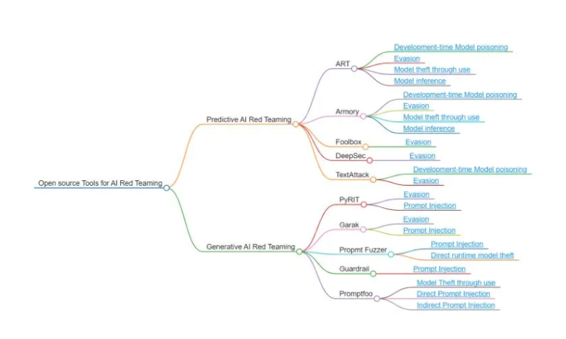
Tools for Red Teaming AI Systems

Slide 59
5. AI Privacy

Slide 60
AI Privacy
Two Key Areas
1. Privacy-Related Security Threats
Protect personal data (train/test, input, output)
Apply conventional security + AI-specific controls
Minimize personal data
Ensure model behavior doesn’t hurt individual privacy
2. Privacy Rights & Regulations (e.g., GDPR)
Rights: consent, access, erasure, transparency
Principles: purpose limitation, fairness, data minimization

Slide 61
Use Limitation & Purpose Specification
Reduce access to sensitive data
Use anonymized copies for analytics
Always define and document the lawful purpose
Communicate purpose clearly to users
Techniques: ✅ Data enclaves ✅ Federated Learning

Slide 62
Fairness in AI
Avoid biased or unfair decisions (e.g., race, gender, age)
Indirect discrimination can still occur
Trade-off: Improving accuracy may increase bias
Tip: Audit datasets and model behavior regularly

Slide 63
Data Minimization & Storage Limitation
Collect only the data you need
Anonymize / aggregate when possible
Set expiration for old data
Restrict access to necessary personnel only

Slide 64
Transparency
Explain how user data is used
Clarify AI decision-making logic
GDPR Article 22: Users can Request human review Contest AI decisions Get explanation of logic
Tip: Keep documentation of datasets & models

Slide 65
Privacy Rights (GDPR)
Users have the right to: Access their data Delete their data Correct errors Object to usage Request data portability
Build systems that respect and enable these rights

Slide 66
Data Accuracy
Wrong data leads to wrong decisions
Validate and update regularly “Garbage in = Garbage out”

Slide 67
Consent
Must be: Informed Specific Auditable Withdrawable anytime
If withdrawn: delete data + retrain models

Slide 68
Model Privacy Attacks
Attack types:
Model Inversion: Guess training data
Membership Inference: Know if someone was in training
Unintended Memorization: Model leaks personal info
Controls:
Differential Privacy
Federated Learning

Slide 69
GDPR – Overview
General Data Protection Regulation Effective since: May 25, 2018 Applies even to non-EU companies handling EU citizens' data
Protects:
Names, emails, IPs
Location data
Sensitive info (health, religion, etc.)

Slide 70
GDPR - Principales
Principle | What It Means
Lawfulness, Fairness, Transparency | Collect legally & explain use
Purpose Limitation | Use only for the original reason
Data Minimization | Collect only what’s needed
Accuracy | Keep data correct
Storage Limitation | Delete when no longer needed
Integrity & Confidentiality | Protect from leaks
Accountability | Prove compliance

Slide 71
GDPR –User Rights
Right | What It Allows
✅ Access | See their data
🧹 Erasure | Ask for deletion
✏️ Correction | Fix wrong data
🙅‍♂️ Objection | Say no to use
📤 Portability | Transfer data
🤖 No Automated Decisions | Ask for human review

Slide 72
Legal Grounds for Using Data (GDPR)
You must have a lawful basis:
✅ Consent
🤝 Contract
⚖️ Legal obligation
❤️ Vital interests
🏛️ Public task
🧠 Legitimate interest
📌 Must balance with user rights

Slide 73

Thanks!

